Slide 1


Peking University
An introduction to unbalanced data classification
2018.11.19
张文涛

Slide 2
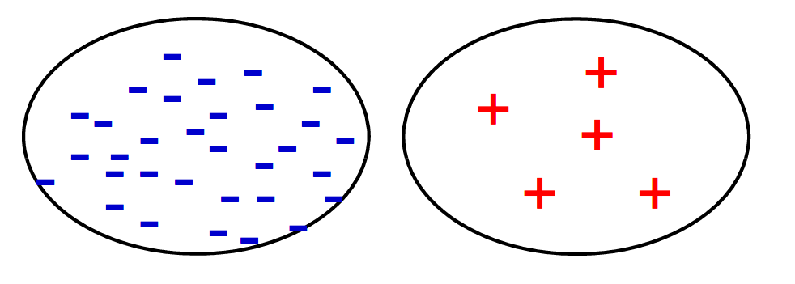
Concept
Peking University
The data contains many more examples of one class than the other.

Slide 3
Background
There exist many domains that do not have a balanced data set.
There are a lot of problems where the most important knowledge usually resides in the minority class.
CTR estimation,
Anti fraud identification
Most ML algorithms are designed to optimize overall accuracy without taking into account the relative distribution of each class.
Peking University

Slide 4
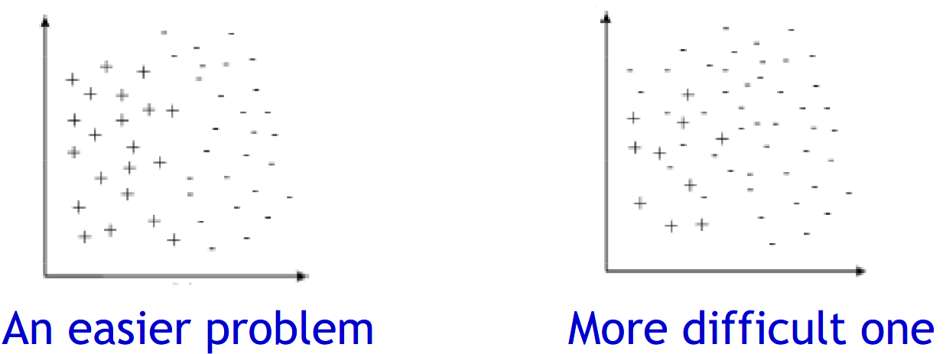
Problem
Peking University
Majority classes overlaps the minority class:
Ambiguous boundary between classes
Influence o of noisy examples
The optimization goal of standard learners is generally the accuracy rate

Slide 5
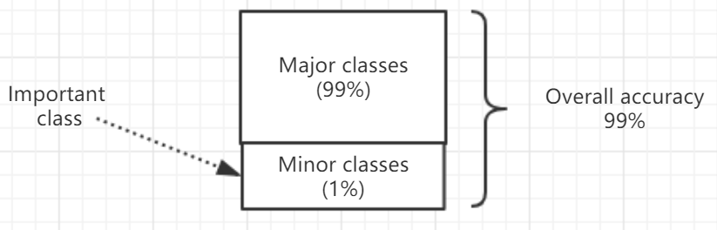
Problem
Standard learners are often biased towards the majority class
Examples from the minority class tend to be misclassified
The classifiers tend to ignore small classes while concentrating on classifying the large ones accurately.
Peking University
If we predict all the data as a positive class, the overall accuracy is as high as 99%, but the auc is 50%

Slide 6
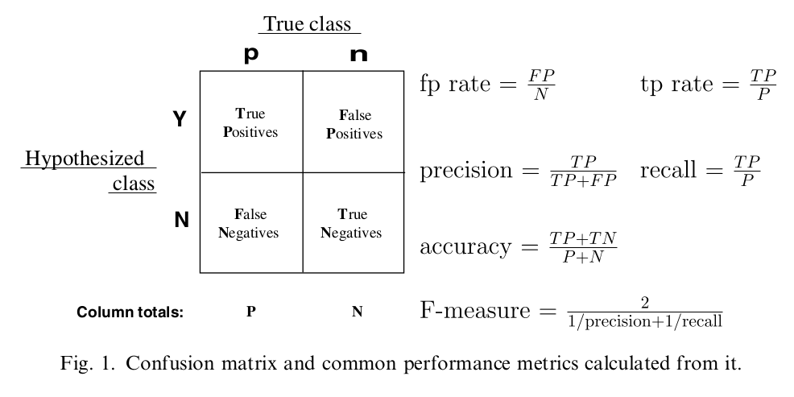
Evaluation
Peking University

Slide 7
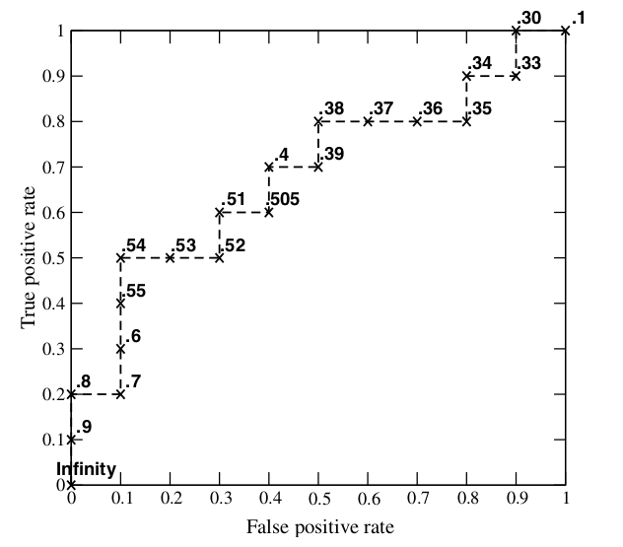
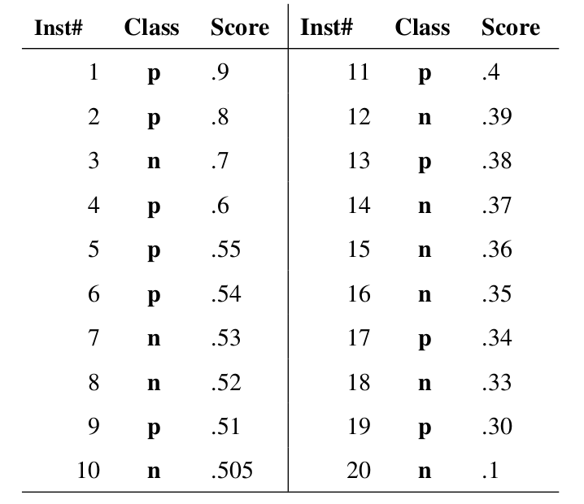
Evaluation
The probability of each sample being predicted as a positive sample
The ROC curve

Slide 8
Strategies to deal with imbalanced data sets
Under sampling
Over sampling
Cost –sensitive
Outlier detection
Ensemble
Peking University

Slide 9
Under sampling
Tomek Links
1NN
NearMiss-1
NearMiss-2
NearMiss-3
NCL
Random
Peking University

Slide 10
Over sampling
Random
Smote
Borderline SMOTE-1
Borderline SMOTE-2
SMOTE + Tomek links
SMOTE+KNN
Peking University

Slide 11
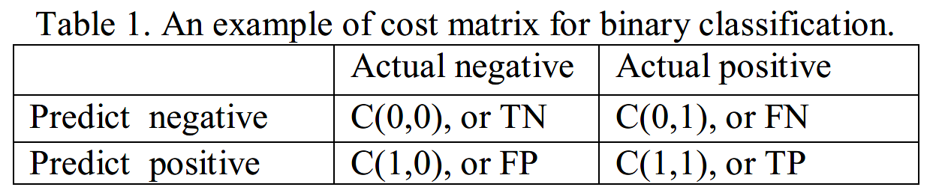
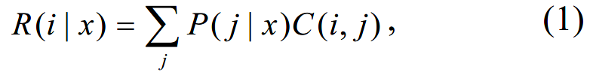
Cost-sensitive
Definition
Peking University
The expected cost：
The classifier will classify an instance $x$ into positive class if and only if:

Slide 12
Cost-sensitive
Direct methods
ICET (Journal of artificial intelligence research, Turney, 1995)
Cost-senstive decision trees (AAAI, Zhou, Z. H, 2006)
Peking University
Meta-learning
Thresholding
MetaCost (SIGKDD, Domingos, 1999)
Cost Sensitive Classifier (CSC in short) (Witten & Frank, 2005)
Cost-sensitive naïve Bayes (Chai et al, 2004)
Empirical Thresholding (ET in short) (Sheng and Ling, 2006)
Sampling
Costing (Zadrozny et al., 2003)
Weighting (Ting, 1998)

Slide 13
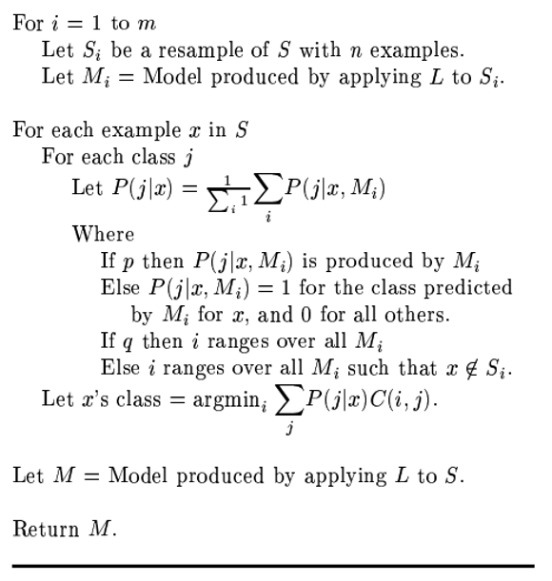
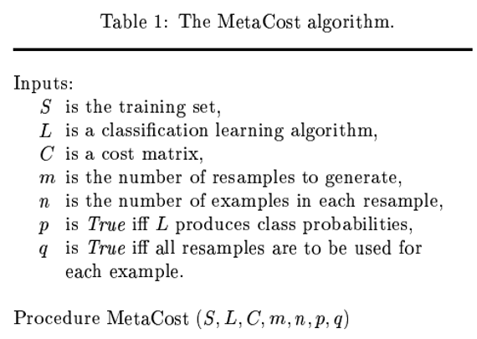
Cost-sensitive
Meta-cost

Slide 14
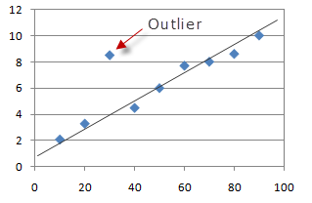
Outlier detection
Definition
Peking University
An outlier is an observation which deviates so much from the other observations as to arouse suspicions that it was generated by a different mechanism.

Slide 15
Outlier detection
Statistical approaches
Depth-based Approaches
Deviation-based Approaches
Distance-based Approaches
Density-based Approaches
High dimensional Approaches
Peking University

Slide 16
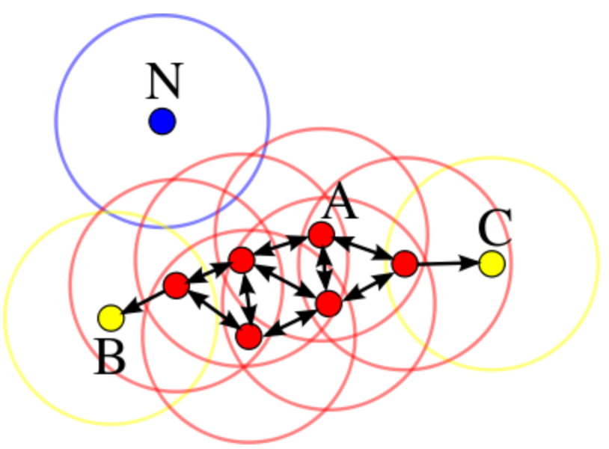
Outlier detection
DBSCAN
Peking University
Core point: A is a core point if its neighborhood (defined by ɛ) contains at least the same number or more points than the parameter M.
Border point: C is a border point that lies in a cluster and its neighborhood does not contain more points than M, but it is still ‘density reachable’ by other points in the cluster.
Outlier: N is an outlier point that lies in no cluster and it is not ‘density reachable’ nor ‘density connected’ to any other point. Thus this point will have “his own cluster”.

Slide 17
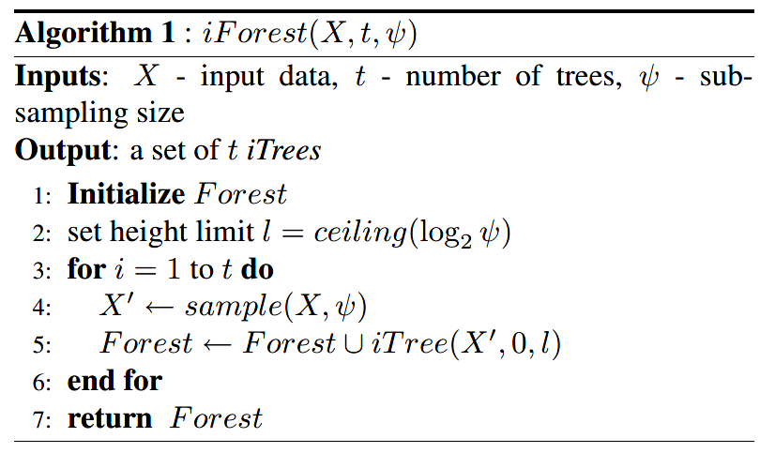
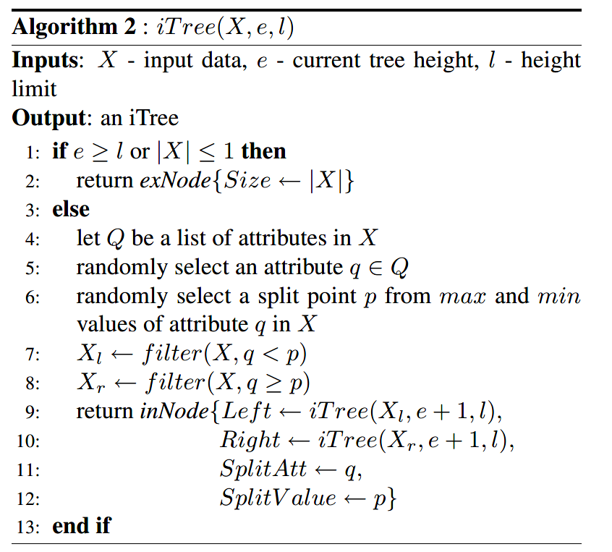
Outlier detection
Isolation Forest(ICDM Best paper, Zhou, Z. H, 2008)
Peking University

Slide 18
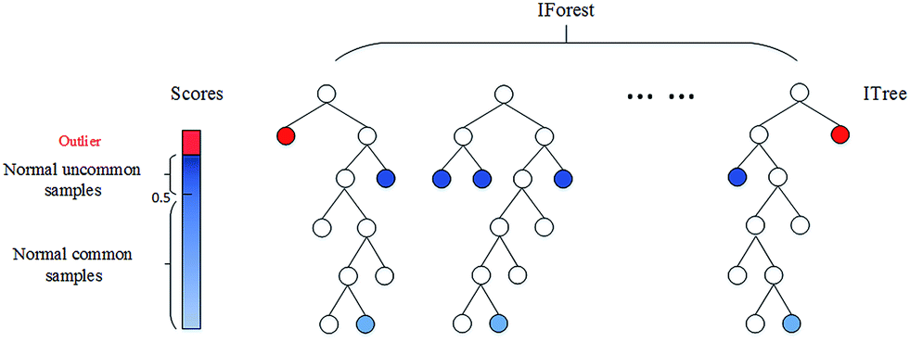
Outlier detection
Isolation Forest
Peking University

Slide 19
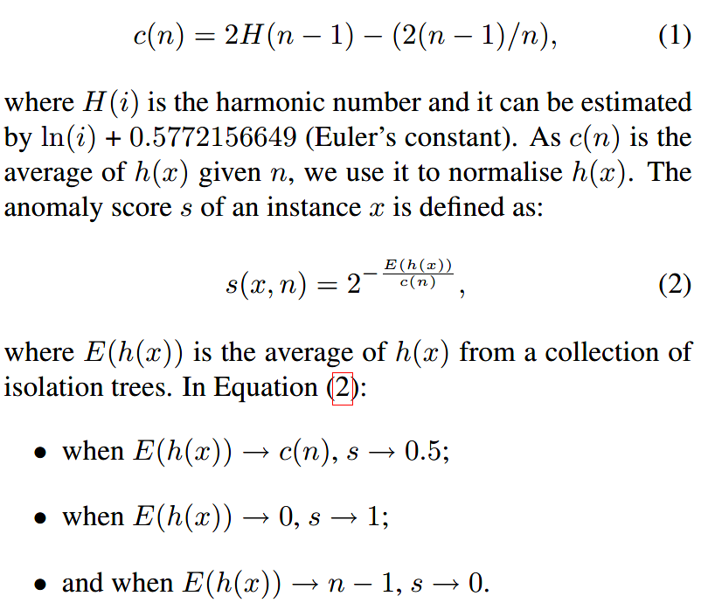
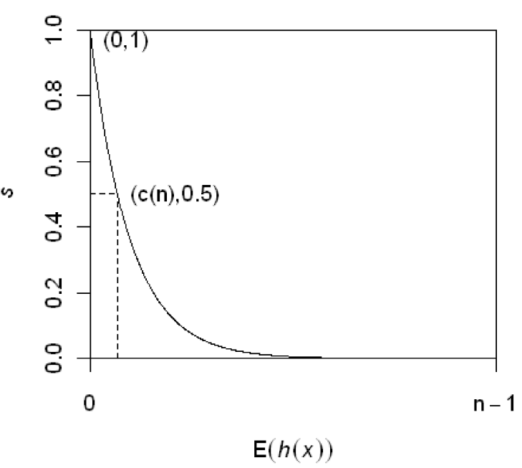
Outlier detection
Isolation Forest
Peking University

Slide 20
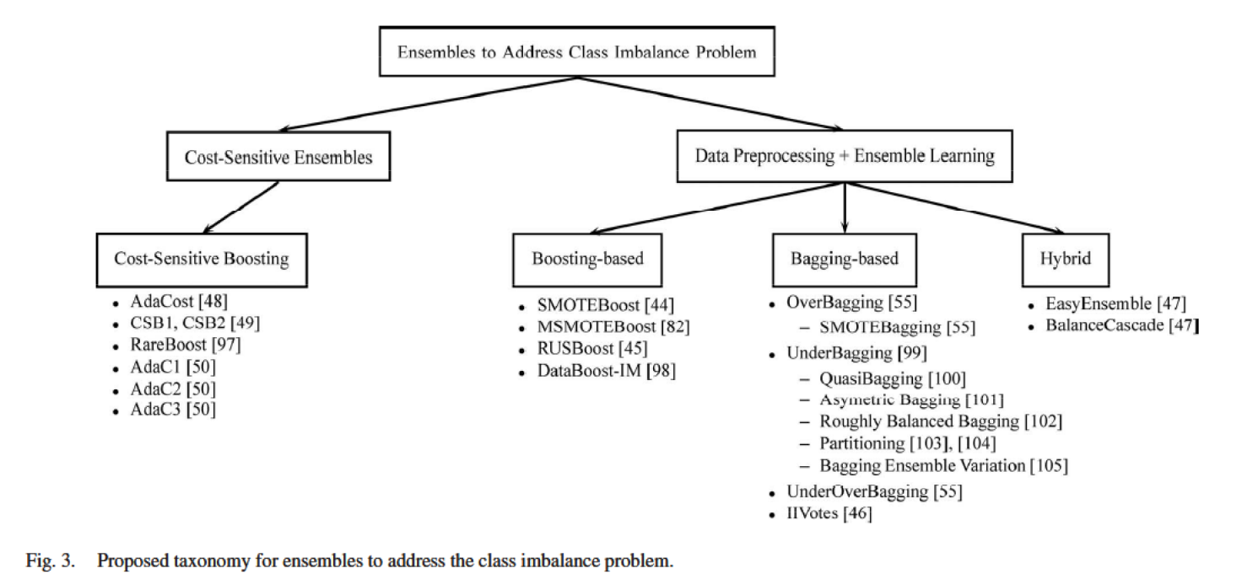
Ensemble
Peking University

Slide 21
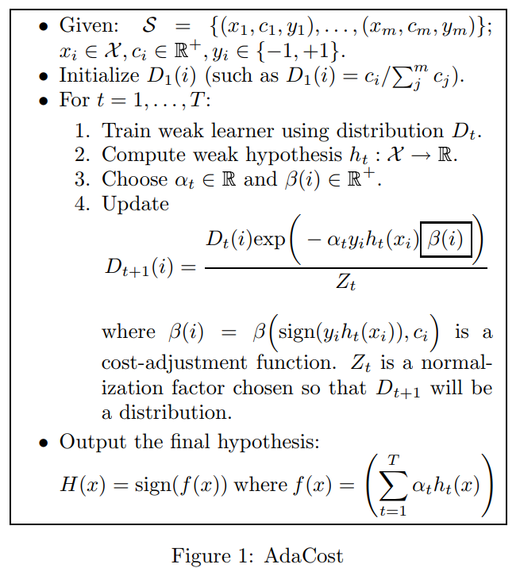
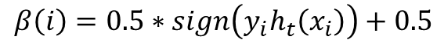
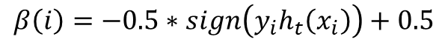
Ensemble
Adacost(ICML,1999)
Peking University
For minority class samples:
$$β\left(i\right)=−0.5∗sign\left(y_{i}h_{t}\left(x_{i}\right)\right)+0.5$$
For majority class samples:
$$β\left(i\right)=0.5∗sign\left(y_{i}h_{t}\left(x_{i}\right)\right)+0.5$$

Slide 22
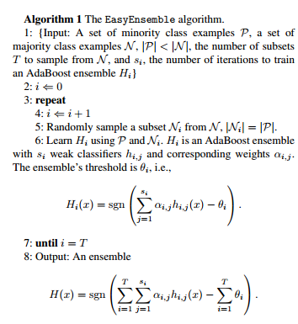
Ensemble
Easy ensemble(IEEE Transactions on Systems, Zhou Z H, 2009)
Peking University
The points obtained by random sampling are not representative.
The performance of each classifier is the same, which is an unreasonable assumption.
Each time we use the same minority class examples, which may cause overfitting.

Slide 23
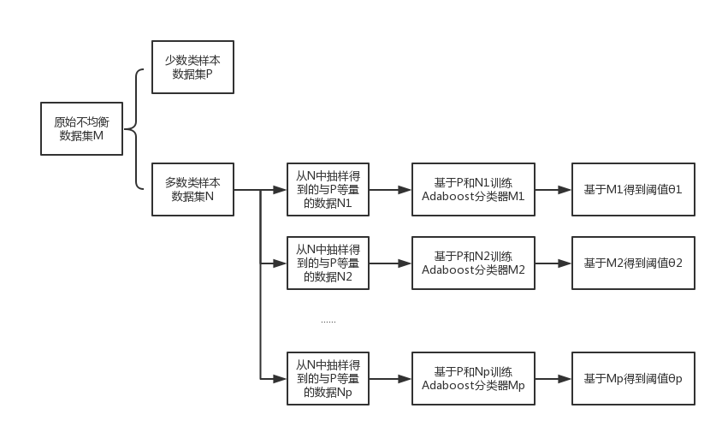
Ensemble
Easy ensemble
Peking University
Peking University

Slide 24
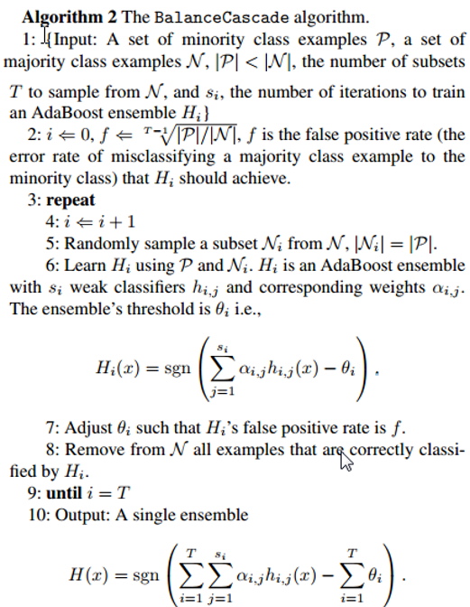
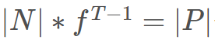
Ensemble
balance cascade (IEEE Transactions on Systems, Zhou Z H, 2009)
Peking University
After T-1 epochs, the number of majority class samples is

